Slide 1
FEBRUARY 2021
FEBRUARY 2021

Slide 2
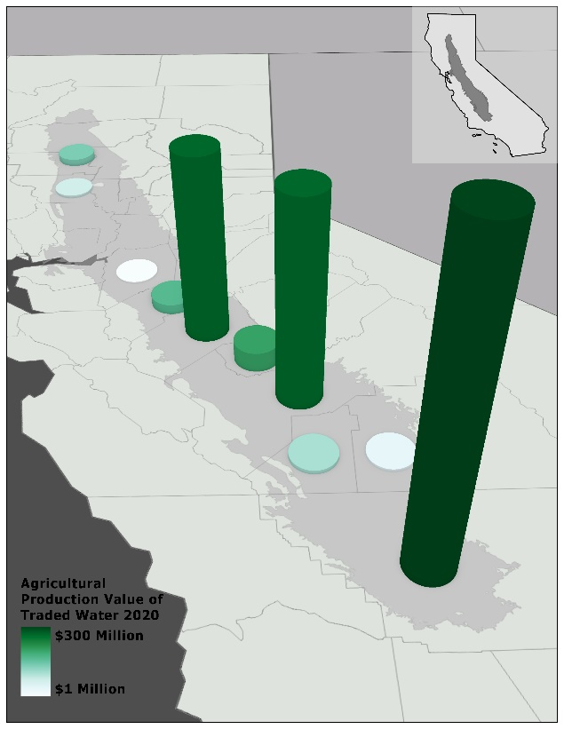

Slide 3
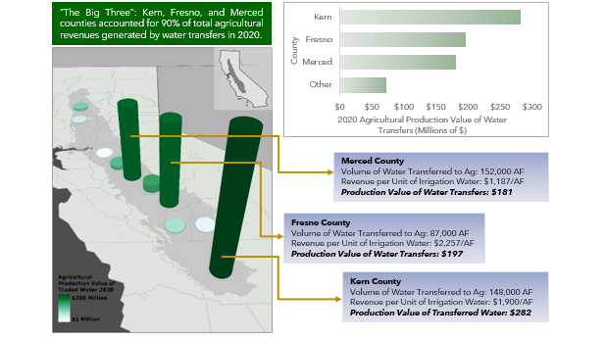

Slide 7
